Slide 1
PROTEIN SYNTHESIS

Slide 2
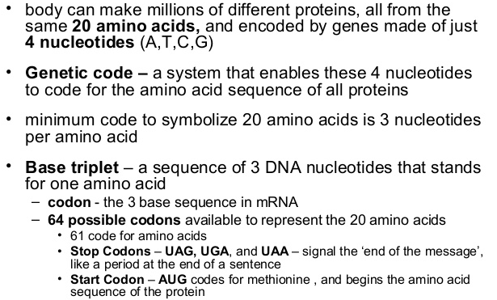
GENETIC CODE

Slide 3
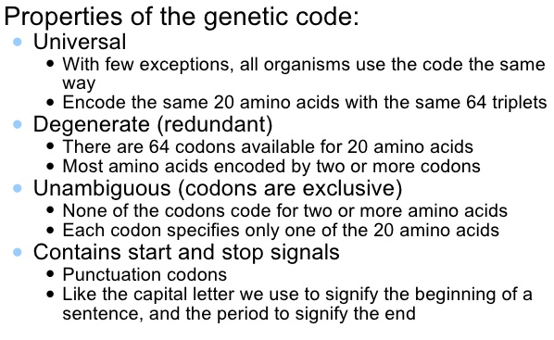
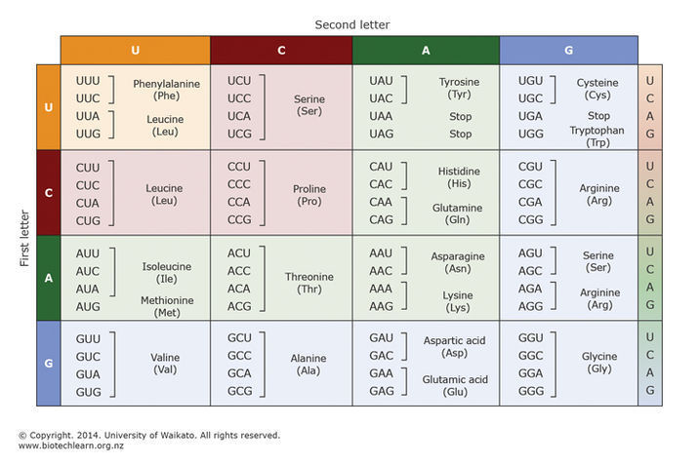

Slide 4
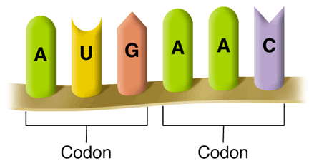
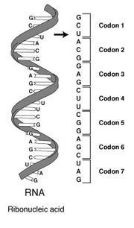
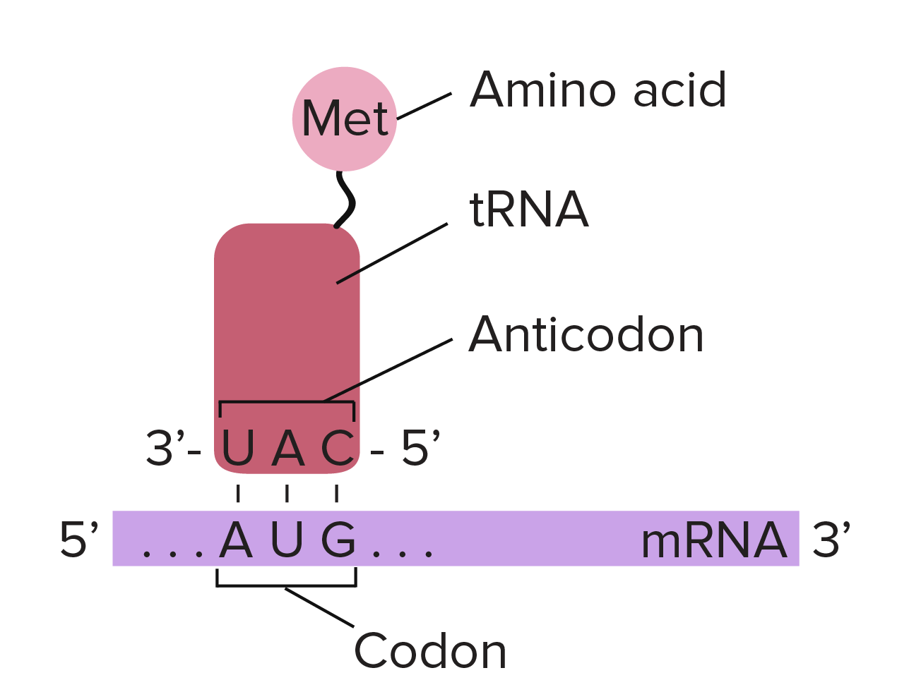
How the code is read?
How the code is read:
Every 3 bases on mRNA represents a code for an amino acid = codon.
Amino acids are abbreviated most times by using the first 3 letters of the amino acid’s name.
Met = methonine
Leu = leucine

Slide 5
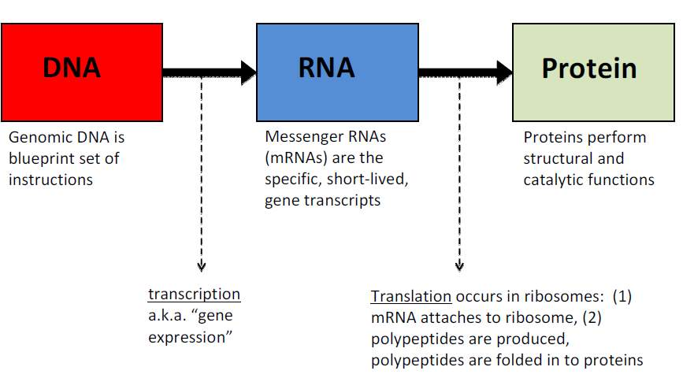
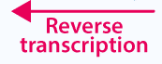
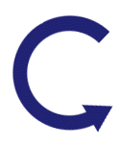
CENTRAL DOGMA
The central dogma is a framework for understanding the flow of genetic information. It states that DNA makes RNA, and RNA makes protein. Again, the process is way more complicated than this. But, when we talk about the steps that occur during any part of this sequence, we say that it's included in the central dogma.
Replication
Notes:
The central dogma suggests that DNA contains the information needed to make all of our proteins, and that RNA is a messenger that carries this information to the ribosomes. The ribosomes serve as factories in the cell where the information is‘translated’from a code into the functional product.
The‘Central Dogma’explains the flow of genetic information in biological systems i.e., it is the process by which the instructions in DNA are converted into a functional product.
It was first proposed in 1958 by Francis Crick, discoverer of the structure of DNA.
The pattern of information flow that occurs frequently in most biological systems is:
(i) From existing DNA to make new DNA (DNA replication)
(ii) From DNA to make RNA (transcription)
(iii) From RNA to make new proteins (translation).
The original central dogma of molecular biology held that DNA was transcribed to RNA, which in turn was translated into protein. However, after discovery of retroviruses, it was updated.
Retroviruses are a class of viruses that use RNA as their genetic material. After infecting a cell, a retrovirus uses an enzyme called reverse transcriptase to convert its RNA into DNA which then is capable of integrating into the host's genome and thus allows the retrovirus to replicate.
These viruses, in contrast to the DNA-to-RNA flow of the central dogma, transcribe RNA into DNA by reverse transcription (hence they“reverse” the flow of information).

Slide 6
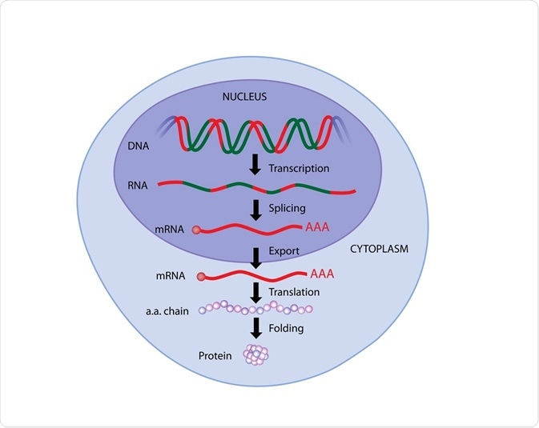
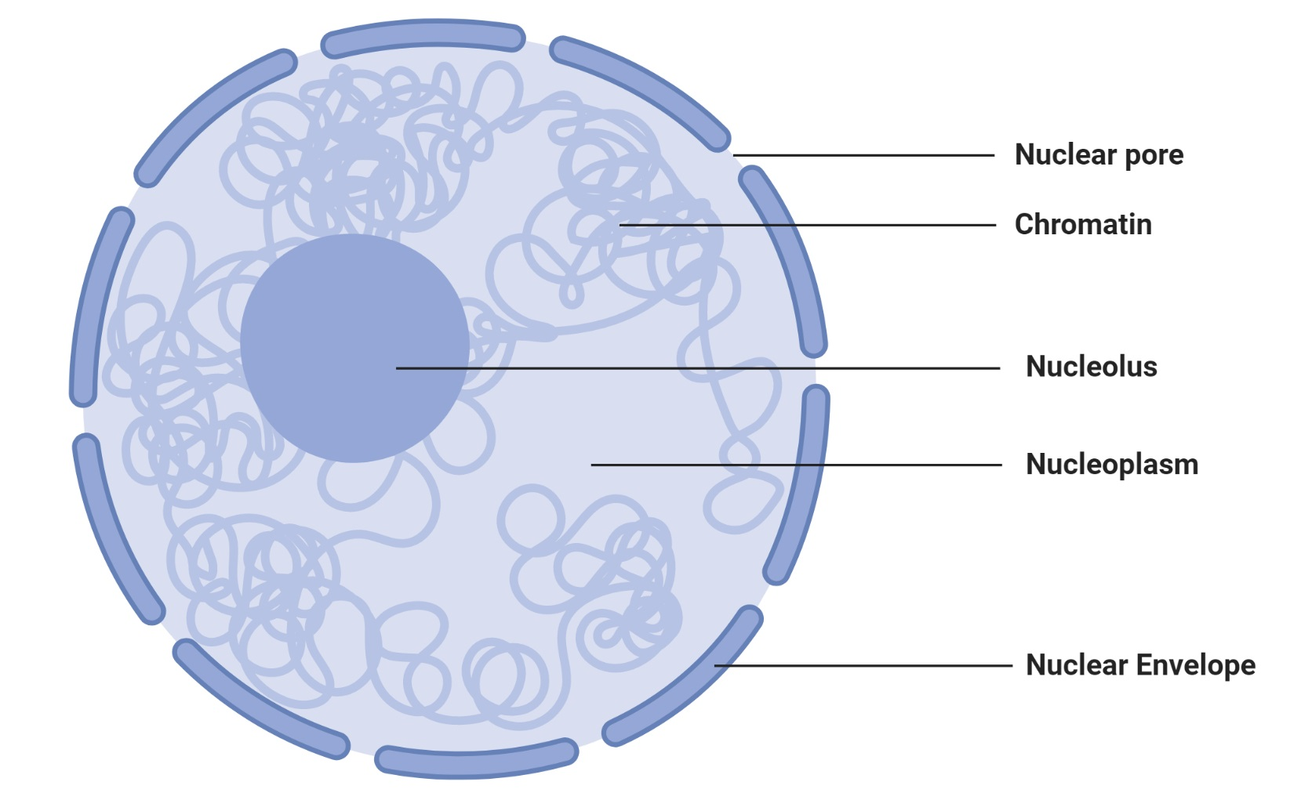
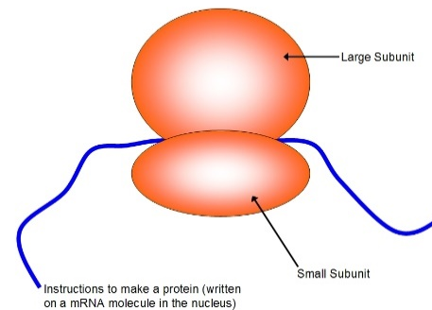
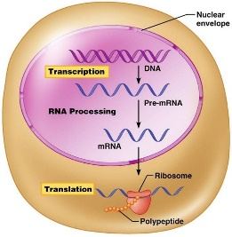
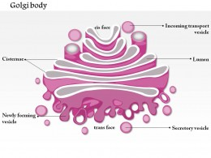
CELL MACHINERY REQUIRED FOR PROTEIN SYNTHESIS
THREE ORGANELLES ARE NEEDED TO CREATE A FUNCTIONAL PROTEIN
NUCLEUS
RIBOSOMES
GOLGI APPARATUS
Pre-mRNA

Slide 7
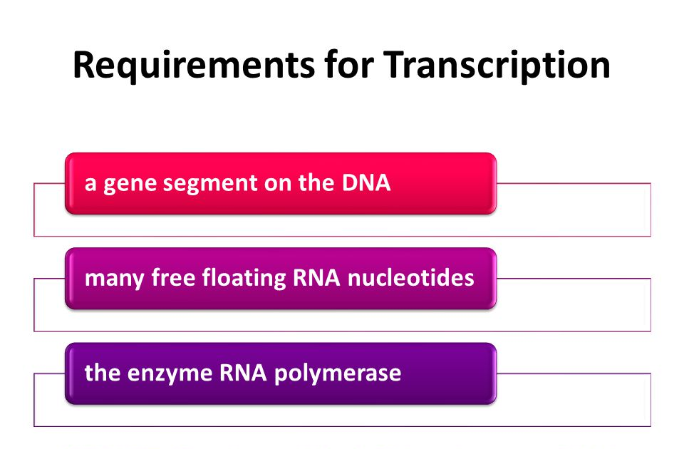

Slide 8
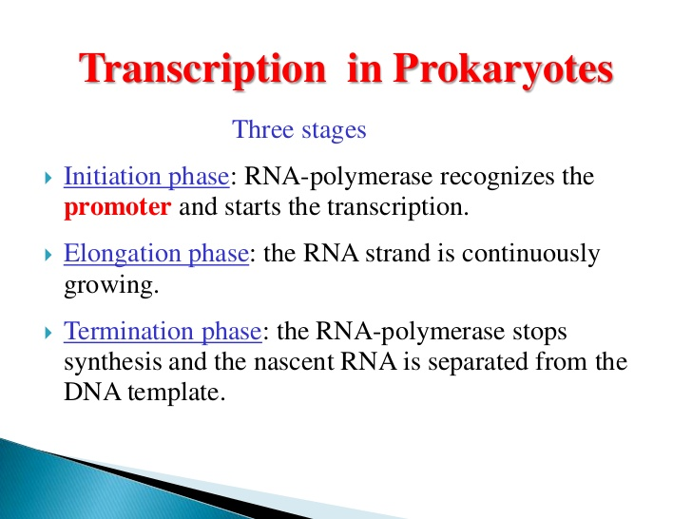
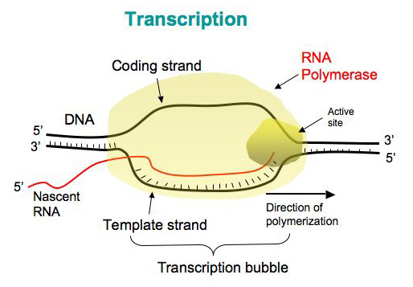
TRANSCRIPTION
The direction of synthesis is always 5' to 3'
Notes:
Transcription - Steps
Initiation: Begins at a site called promoter. Recognised by the presence of a TATA box. RNA Polymerase enzymes binds here. The region before this is known as Upstream and the region after will be transcribed and is known as Downstream
Elongation: As the RNA moves downstream unwinding of DNA happens and the new RNA strand gets synthesized. The direction of synthesis is always 5' to 3'
Termination: RNA will stop adding complementary sequences once it receives a stop signal. RNA polymerase leaves the DNA strand. mRNA falls of. this form of RNA is known as pre-mRNA.

Slide 9
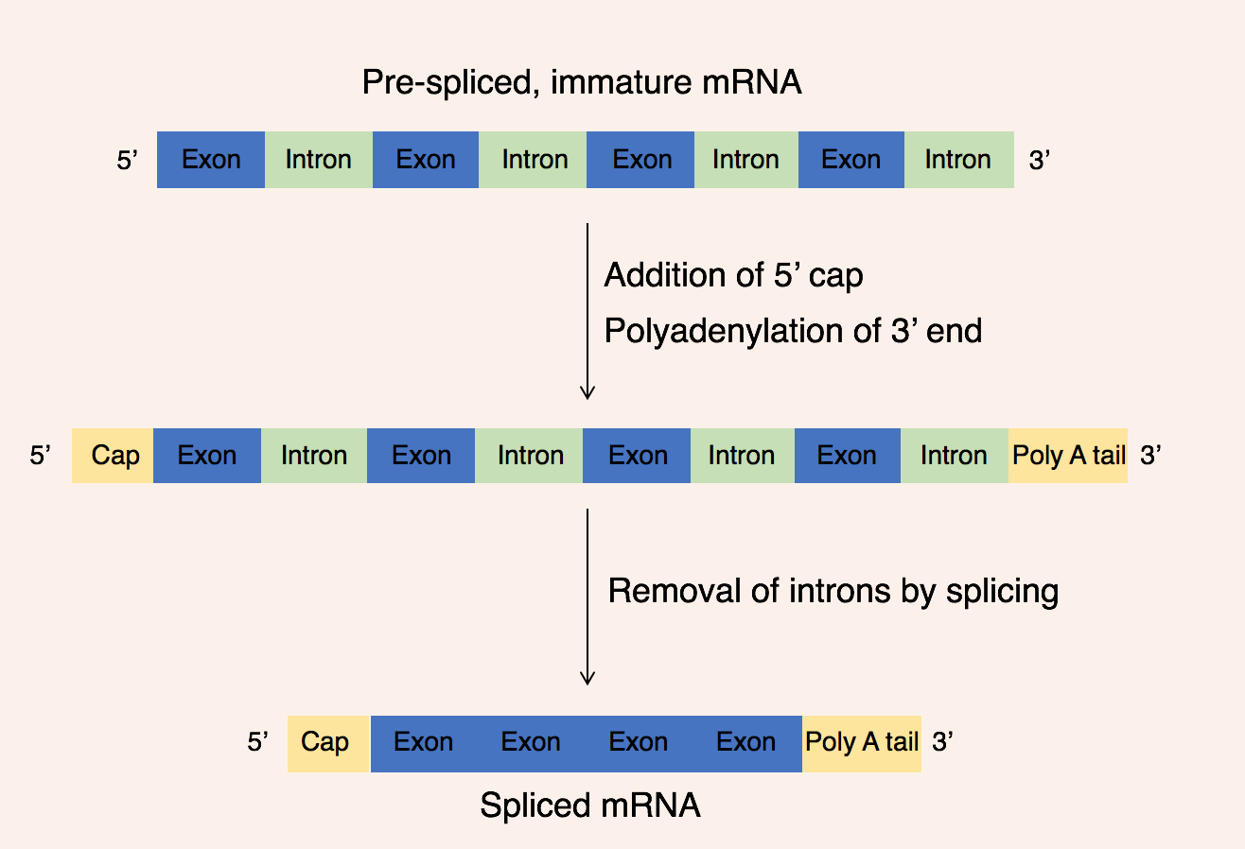
mRNA EDITING - SPLICING
There are some parts of the DNA sequence that aren’t involved in coding for proteins. These parts are called introns, and the introns must be removed from mRNA.
The parts that are involved in coding are called exons.
Pre-mRNA has to be edited in order to remove the introns and make a complete coding set. This is achieved by a process called splicing.
Notes:
Splicing is a process of joining of exons after removal of introns.

Slide 10
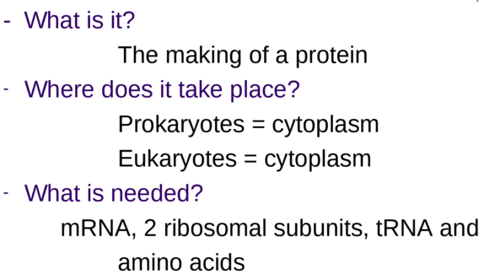
TRANSLATION

Slide 11
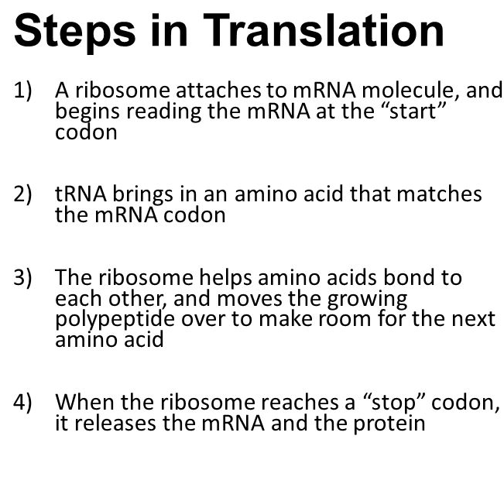
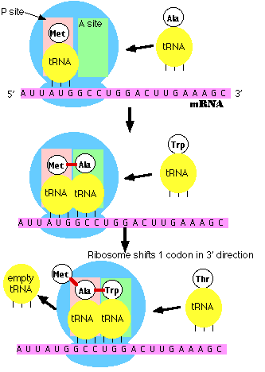
INITIATION
ELONGATION
Codons are read 5' → 3' as the protein is synthesized from amino end to carboxyl end
TERMINATION

Slide 12
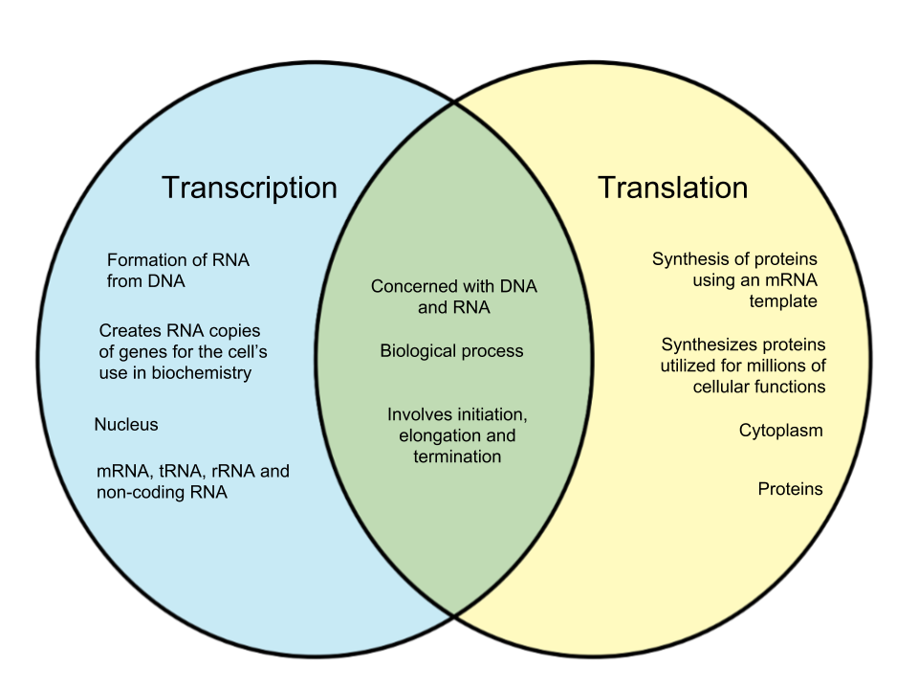
DIFFERENCE BETWEEN TRANSCRIPTION AND TRANSLATION

Slide 13
Questions
What is “Central dogma of life”?
What is the difference between transcription and translation?
Describe the steps involved in transcription.
Describe the steps involved in translation.
What do you mean by splicing?

